Slide 1


Selenium WebDriver Basic
Selenium WebDriver Setup; Browser Commands; WebElements; FindElements; Basic Operations; X-Path
QA
Automation
SoftUni Team
Technical Trainers
Software University
http://softuni.bg

Slide 2

Table of Contents
Selenium Webdriver setup , Selenium Webdriver Architecture, JSON Wire protocol in action
Browser Commands
WebElements
FindElements
Basic Operations
XPath

Slide 3
Have a Question?
sli.do #QA-Auto

Slide 4
Selenium WebDriver Setup
Setup and Overview

Slide 5
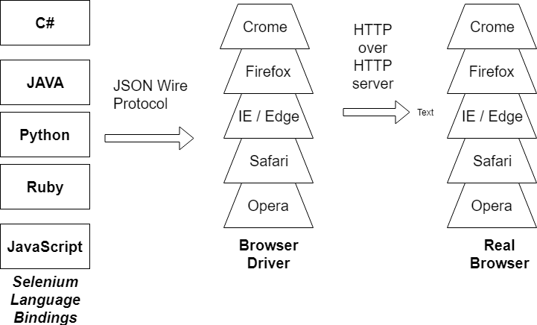
Selenium WebDriver Architecture

Slide 6
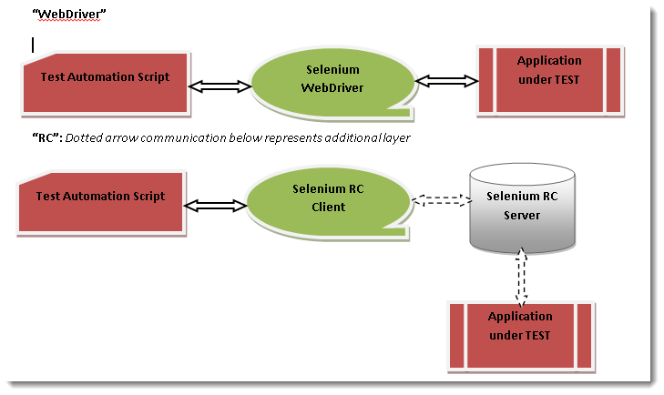
Selenium WebDriver and RC Model

Slide 7
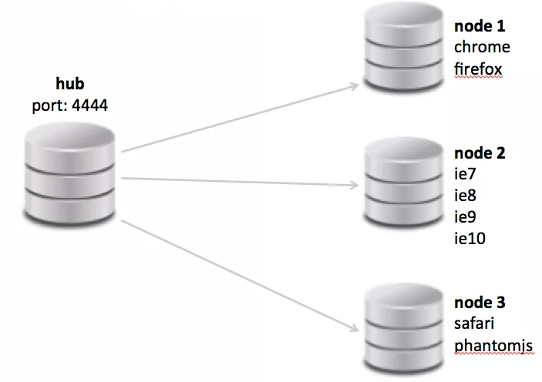
Selenium Grid
Many browsers per node

Slide 8
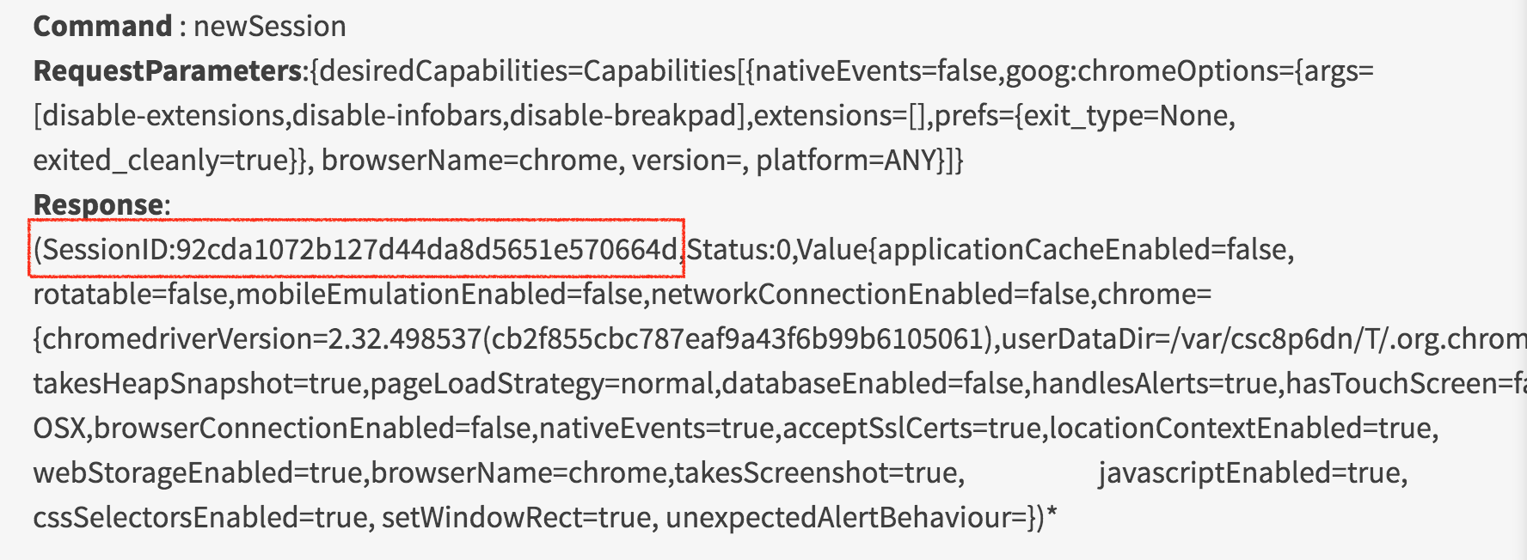
JSON wire protocol in action
Create session - The first step is to create a session with the respective driver like ChromeDriver or FirefoxDriver and use the same session Id to communicate between client and server. Session command above created SessionID:92cda1072b127d44da8d5651e570664d with Server and now every request must pass the same sessionId in all the next requests.

Slide 9
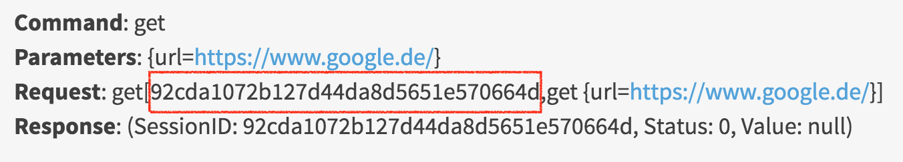
JSON wire protocol in action
Opening the Test URL - Now after creating a successful session with the driver, next step is to open URL

Slide 10
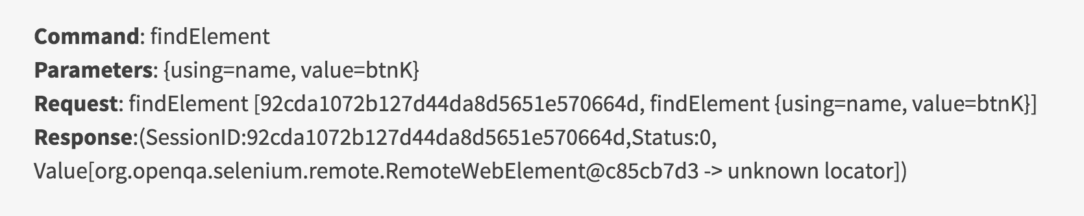
JSON wire protocol in action
Find Element - Now the Test URL is opened in the browser, next step is to find the Element on webpage

Slide 11
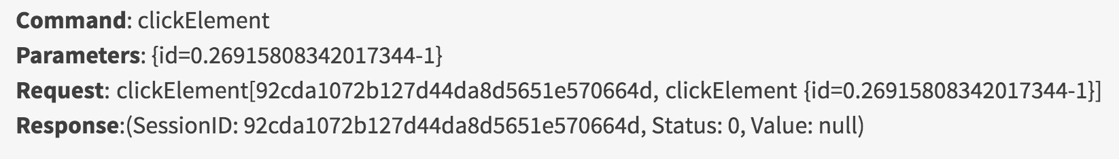
JSON wire protocol in action
Click Element - Now we have found the Element and received the ID assigned by the server in the response. Now we will send the click command with the same ElementID. Click request contains the session and Element Id.

Slide 12
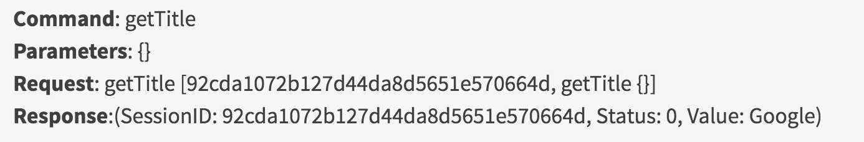
JSON wire protocol in action
Get Page Title - Our Next Step is to Get the Title from the WebPage and WebDriver use the getTitle command without any of the request Body.

Slide 13
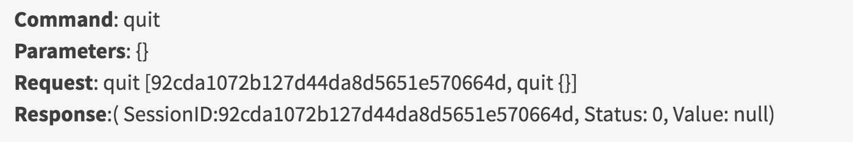
JSON wire protocol in action
Quit Driver - After every Test finished you should quit the driver, Quit call close the browser and clean the session. WebDriver use the quit command now

Slide 14


Browser Commands

Slide 15
Browser commands
URL Command
string IWebDriver.Url { get; set;} – This method Load a new web page in the current browser window. This method get and set the value and can be used both ways.
Command – driver.Url = “appUrl”; //To open the Url
Command – String Url = driver.Url; // To get the opened Url
Where appUrl is the website address to load. It is best to use a fully qualified URL.
Example:
driver.Url = ("http://www.google.com");

Slide 16
Browser commands
Title Command
string IWebDriver.Title{ get;} – This method fetches the Title of the current page. Accepts nothing as a parameter and returns a String value.
Command – driver.Title;
As the return type is String value, the output must be stored in String object/variable.
Example:
String Title = driver.Title;

Slide 17
Browser commands
Page Source Command
string IWebDriver.PageSource{ get;} – This method returns the Source Code of the page. Accepts nothing as a parameter and returns a String value.
Command – driver.PageSource;
As the return type is String value, the output must be stored in String object/variable.
Example:
String PageSource = driver.PageSource;

Slide 18
Browser commands
Close Command
void IWebDriver.Close() – This method Close only the current window the IWebDriver is currently controlling. Accepts nothing as a parameter and returns nothing.
Command – driver.Close();
Quit the browser if it’s the last window currently open.
Example:
driver.Close();

Slide 19
Browser commands
GoToUrl Command
This command is used to navigate to a particular page. Signature of this command is
void INavigation.GoToUrl(String url) : This command takes a String value of the URL as input parameter and returns void. Once this statement is executed browser navigates to the new page specified by the URL parameter.
Command – driver.Navigate().GoToUrl(appUrl);
Where appUrl is the website address to load. It is best to use a fully qualified URL.
Usage:
driver.Navigate().GoToUrl("http://google.com");

Slide 20
Browser commands
Back Command
Back command is used navigate to the previous page in the browser history. This is exactly similar to what happens when you click on the back button in your browser.
void INavigation.Back() : This command does not take any parameter.
Takes you back by one page on the browser’s history.
Usage:
driver.Navigate().Back();

Slide 21
Browser commands
Forward Command
Forward command is used to navigate to the next page in the browser history. This exactly similar to what happens when you click on the forward button in your browser, if you have some history in forward direction
void INavigation.Forward() : This command does not takes any parameter.
Takes you forward by one page on the browser’s history.
Usage:
driver.Navigate().Forward();

Slide 22
Browser commands
Refresh Command
This command refreshes the page as if you have pressed F5 on the browser.
void INavigation.Refresh() : This command does not takes any parameter
Usage:
driver.Navigate().Refresh();

Slide 23
WebElements

Slide 24
WebElements
Clear Command
void IWebElement.Clear() – If this element is a text entry element, this will clear the value. This method accepts nothing as a parameter and returns nothing.
Command – element.Clear();
This method has no effect on other elements. Text entry elements are INPUT and TEXTAREA elements.
Example
IWebElement element = driver.findElement(By.Id("UserName"));
element.Clear();
//Or can be written as
driver.FindElement(By.Id("UserName")).Clear();

Slide 25
WebElements
SendKeys Command
void IWebElement.SendKeys(string text) – This simulate typing into an element, which may set its value. This method accepts string as a parameter and returns nothing.
Command – element.SendKeys(“text”);
This method works fine with text entry elements like INPUT and TEXTAREA elements.
Example
IWebElement element = driver.FindElement(By.Id("UserName"));
element.SendKeys("QA");
//Or can be written as
driver.FindElement(By.Id("UserName")).SendKeys("QA");

Slide 26
WebElements
Click Command
void IWebElement.Click()– This simulates the clicking of any element. Accepts nothing as a parameter and returns nothing.
Command – element.Click();
Clicking is perhaps the most common way of interacting with web elements like text elements, links, radio boxes and many more.
Example
IWebElement element = driver.FindElement(By.LinkText("Tools"));
element.Click();
//Or can be written as
driver.FindElement(By.LinkText("Tools")).Click();
Note: Most of the time we click on the links and it causes a new page to load, this method will attempt to wait until the page has loaded properly before handing over the execution to next statement. But If Click() causes a new page to be loaded via an event or is done by sending a native event for example through javascript, then the method will not wait for it to be loaded.
There are some preconditions for an element to be clicked. The element must be Visible and it must have a Height and Width greater than 0.

Slide 27
WebElements
Displayed Command
bool IWebElement.Displayed{ get; } – This method determines if an element is currently being displayed or not. This accepts nothing as a parameter but returns boolean value(true/false).
Command – element.Displayed;
Example
IWebElement element = driver.FindElement(By.Id("UserName"));
bool status = element.Displayed;
//Or can be written as
bool staus = driver.FindElement(By.Id("UserName")).Displayed;
Note: Do not confuse this method with element present on the page or not. This will return true if the element is present on the page and throw a NoSuchElementFound exception if the element is not present on the page. This refers the property of the element, sometimes the element is present on the page but the property of the element is set to hidden, in that case this will return false, as the element is present in the DOM but not visible to us.

Slide 28
WebElements
Enabled Command
bool IWebElement.Enabled{ get; } – This determines if the element currently is Enabled or not? This accepts nothing as a parameter but returns boolean value(true/false).
Command – element.Enabled;
This will generally return true for everything but I am sure you must have noticed many disabled input elements in the web pages.
Example
IWebElement element = driver.FindElement(By.Id("UserName"));
bool status = element.Enabled;
//Or can be written as
bool staus = driver.FindElement(By.Id("UserName")).Enabled;
//Or can be used as
IWebElement element = driver.FindElement(By.Id("UserName"));
bool status = element.Enabled;
// Check that if the Text field is enabled, if yes enter value
if(status){
element.SendKeys(“QA");
}

Slide 29
WebElements
Selected Command
bool IWebElement.Selected{ get; } – Determine whether or not this element is selected or not. This accepts nothing as a parameter but returns boolean value(true/false).
Command – element.Selected;
This operation only applies to input elements such as Checkboxes, Select Options and Radio Buttons. This returns True if the element is currently selected or checked, false otherwise.
Example
IWebElement element = driver.FindElement(By.Id("Sex-Male"));
bool status = element.Selected;
//Or can be written as
bool staus = driver.FindElement(By.Id("Sex-Male")).Selected;

Slide 30
WebElements
Submit Command
void IWebElement.Submit() – This method works well/better than the Click() if the current element is a form, or an element within a form. This accepts nothing as a parameter and returns nothing.
Command – element.Submit();
If this causes the current page to change, then this method will wait until the new page is loaded.
Example
IWebElement element = driver.FindElement(By.Id("SubmitButton"));
element.Submit();
//Or can be written as
driver.FindElement(By.Id("SubmitButton")).Submit();

Slide 31
WebElements
Text Command
string IWebElement.Text{ get; } – This method will fetch the visible (i.e. not hidden by CSS) innerText of the element. This accepts nothing as a parameter but returns a String value.
Command – element.Text;
This returns an innerText of the element, including sub-elements, without any leading or trailing whitespace.
Example
IWebElement element = driver.FindElement(By.Xpath("anyLink"));
String linkText = element.Text;

Slide 32
WebElements
TagName Command
string IWebElement.TagName{ get; } – This method gets the tag name of this element. This accepts nothing as a parameter and returns a String value.
Command – element.TagName();
This does not return the value of the name attribute but return the tag for e.g. “input“ for the element <input name="foo"/>.
Example
IWebElement element = driver.FindElement(By.Id("SubmitButton"));
String tagName = element.TagName;
//Or can be written as
String tagName = driver.FindElement(By.Id("SubmitButton")).TagName;

Slide 33
WebElements
GetCssValue Command
string IWebElement.GetCssValue(string propertyName) – This method Fetch CSS property value of the given element. This accepts string as a parameter which is property name.
Command – element.GetCssValue();
Color values should be returned as rgba strings, so, for example if the “background-color” property is set as “green” in the HTML source, the returned value will be “rgba(0, 255, 0, 1)”.

Slide 34
WebElements
GetAttribute Command
string IWebElement.GetAttribute(string attributeName) – This method gets the value of the given attribute of the element. This accepts the String as a parameter and returns a String value.
Command – element.GetAttribute();
Attributes are Ids, Name, Class extra and using this method you can get the value of the attributes of any given element.
Example
IWebElement element = driver.FindElement(By.Id("SubmitButton"));
String attValue = element.GetAttribute("id"); //This will return "SubmitButton"

Slide 35
WebElements
Size Command
System.Drawing.Size IWebElement.Size{ get; } – This method fetch the width and height of the rendered element. This accepts nothing as a parameter but returns the Dimension object.
Command – element.Size();
This returns the size of the element on the page.
Example
IWebElement element = driver.FindElement(By.Id("SubmitButton"));
Dimension dimensions = element.Size();
Console.WriteLine(“Height :” + dimensions.Height + ”Width : "+ dimensions.Width);

Slide 36
WebElements
Location Command
System.Drawing.Location IWebElement.Location{ get; } – This method locate the location of the element on the page. This accepts nothing as a parameter but returns the Point object.
Command – element.Location();
This returns the Point object, from which we can get X and Y coordinates of specific element.
Example
IWebElement element = driver.FindElement(By.Id("SubmitButton"));
Point point = element.Location;
Console.WriteLine("X cordinate : " + point.X + "Y cordinate: " + point.Y);

Slide 37
FindElements

Slide 38
FindElements
By ID
By By.Id(string idToFind) – This is the most efficient and preferred way to locate an element, as most of the times IDs are unique. It takes a parameter of String which is a Value of ID attribute and it returns a BY object to FindElement() method.
Command – driver.FindElement(By.Id(“Element ID”));
With this strategy, If no element has a matching id attribute, a NoSuchElementException will be raised.
Example
IWebElement element = driver.FindElement(By.Id("submit"));
// Action can be performed on Input Button element
element.Submit();

Slide 39
FindElements
By Name
By By.Name(string nameToFind) – This is also an efficient way to locate an element but again the problem is same as with ID that UI developer make it having non-unique names on a page or auto-generating the names. It takes a parameter of String which is a Value of NAME attribute and it returns a BY object to FindElement() method.
Command – driver.FindElement(By.Name(“Element NAME”));
With this strategy, the first element with the name attribute value matching the location will be returned. If no element has a matching name attribute, a NoSuchElementException will be raised.
Example
IWebElement element = driver.FindElement(By.Name("firstname"));
// Action can be performed on Input Text element
element.SendKeys("QA")

Slide 40
FindElements
By ClassName
By By.ClassName(string clasNameToFind) – This finds elements based on the value of the CLASS attribute. It takes a parameter of String which is a Value of CLASS attribute and it returns a BY object to FindElement() method.
Command – driver.FindElement(By.ClassName(“Element CLASSNAME”));
If an element has many classes then this will match against each of them.
Example
IWebElement parentElement = driver.FindElement(By.ClassName("button"));
IWebElement childElement = parentElement.FindElement(By.Id("submit"));
childElement.Submit();

Slide 41
FindElements
By TagName
By By.TagName(string tagNameToFind) – With this you can find elements by their TAGNAMES. It takes a parameter of String which is a Value of TAG attribute and it returns a BY object to FindElement() method.
Command – driver.FindElement(By.TagName(“Element TAGNAME”));
Locating Element By Tag Name is not too much popular because in most of cases, we will have other alternatives of element locators. But yes if there is not any alternative then you can use element’s DOM Tag Name to locate that element in WebDriver.
Example
IWebElement element = driver.FindElement(By.TagName("button"));
// Action can be performed on Input Button element
element.Submit();

Slide 42
FindElements
By LinkText & PartialLinkText
By By.LinkText(string linkTextToFind) – With this you can find elements of “a” tags(Link) with the link names. Use this when you know link text used within an anchor tag. It takes a parameter of String which is a Value of LINKTEXT attribute and it returns a BY object to FindElement() method.
By By.PartialLinkText(string partialLinkTextToFind) – With this you can find elements of “a” tags(Link) with the partial link names.
Command – driver.FindElement(By.LinkText(“Element LINKTEXT”));
Command – driver.FindElement(By.PartialLinkText(“Element LINKTEXT”));
If your targeted element is link text then you can use by link text element locator to locate that element. Partial Link Text is also same as Link text, but in this we can locate element by partial link text too. In that case we need to use By.PartialLinkText at place of By.LinkText.
Example
IWebElement element = driver.FindElement(By.LinkText("Partial Link Test"));
element.Clear();
//Or can be identified as
IWebElement element = driver.FindElement(By.PartialLinkText("Partial");
element.Clear();

Slide 43
FindElements
By XPath
By By.XPath(string xPathToFind)– It is most popular and majorly used locating element technique or the easiest way to locate element in WebDriver. It takes a parameter of String which is a XPATHEXPRESSION and it returns a BY object to FindElement() method.
Command – driver.FindElement(By.XPath(“Element XPATHEXPRESSION”));
The best thing in xpath is that it provides many different technique to locate elements. It gives you feature to locate single element in many ways.

Slide 44
FindElements
Difference between FindElement & FindElements Commands
The difference between FindElement() and FindElements() method is the first returns a WebElement object otherwise it throws an exception and the latter returns a List of WebElements, it can return an empty list if no DOM elements match the query.
FindElement()
On Zero Match : throws NoSuchElementException
On One Match : returns WebElement
On One+ Match : returns the first appearance in DOM
FindElements()
On Zero Match : return an empty list
On One Match : returns list of one WebElement only
On One+ Match : returns list with all matching instance

Slide 45
Basic operations

Slide 46
Basic operation
How to Handle Window in Selenium CSharp?
To uniquely identify an opened browser Selenium WebDriver keeps a map of Opened windows VS Window Handle. Window handle is a unique string value that uniquely identifies a Browser window on desktop. It is guaranteed that each browser will have a unique window handle. To get Window handle WebDriver interface provides two methods CurrentWindowHandle – WindowHandles

Slide 47
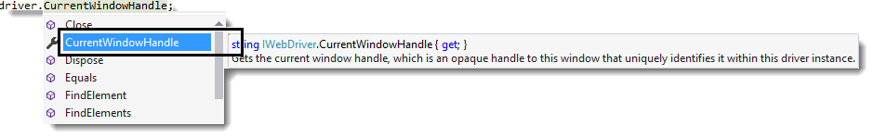
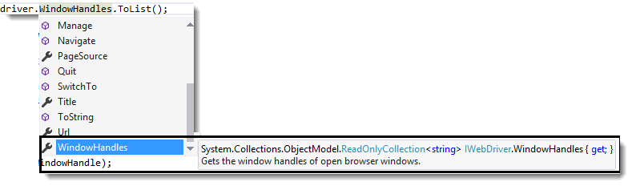
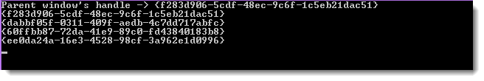
Basic operation

Slide 48
Basic operation
CurrentWindowHandle method return a string value and it returns the Window handle of current focused browser window. WindowHandles. This method returns a ReadOnlyCollection (You need to typecast this collection to List Collection by using ToList()) of all Window handles of all the browsers that were opened in the session.

Slide 49
Basic operation
How to Handle Multiple Windows in Selenium CSharp?
There is a concept of current focused window which means that all selenium webdriver commands will go to the focused window. By default the focus is always on the Parent window, please see the screenshot above. In order to shift focus from Parent Window to any child window we have to use the following command on WebDriver – driver.SwitchTo().Window(String WindowHandle); This command takes in a window handle and switches the driver context on that window. Once the Switch happens all the driver commands will go to the newly focused window. This is very important to understand, without switching to the desired window we will not be able to perform any action on that window. Now lets see some code which iteratively moves across all the open windows and navigates to a particular page in all the open windows one by one.

Slide 50
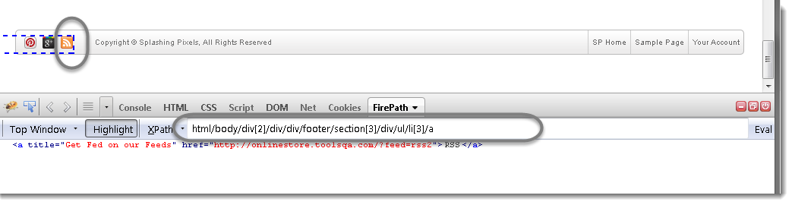
Xpath
Exampe
Let’s take an example of RSS button at the bottom of the page in the footer section of www.store.demoqa.com.

Slide 51
Xpath
Technique 1 | Absolute XPath: The easiest way of finding the xpath is to use the Browser Inspector tool to locate an element and get the xpath of it:
XPath Generated by the tool is : /html/body/div[2]/div/div/footer/section[3]/div/ul/li[3]/a

Slide 52
Xpath
Technique 2 | Relative XPath: At times XPath generated by Firebug are too lengthy and you see there is a possibility of getting a shorter XPath. Above xpath will technically work, but each of those nested relationships will need to be present 100% of the time, or the locator will not function. Above choosed xpath is known as Absolute xpath. There is a good chance that your xpath will vary in every release. It is always better to choose Relative xpath, as it helps us to reduce the chance of element not found exception.
To choose the relative xpath, it is advisable to look for the recent Id attribute. Look below at the HTML code of the above screen shot.

Slide 53
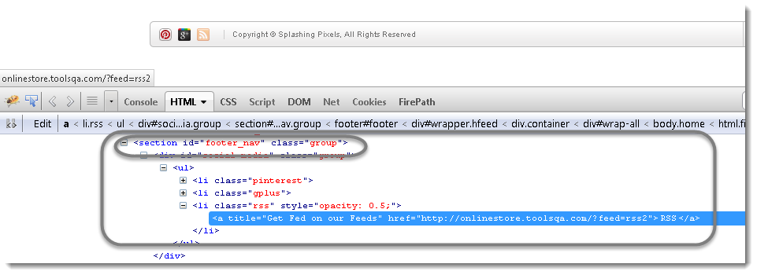
Xpath
You can see the recent or last Id produced is ‘footer_nav‘. This id would be appropriate in this case, so a quality xpath will look like this: //*[@id=’social-media’]/ul/li[3]/a
Did you notice the difference between the Absolute and Relative xpaths?
Absolute xpath: /html/body/div[2]/div/div/footer/section[3]/div/ul/li[3]/a
Relative xpath: //*[@id=’social-media’]/ul/li[3]/a
Absolute xpath is using single slash at the start of the xpath and relative is using double slash.

Slide 54
Xpath
Technique 3 | Relative XPath | Combination of Double Slash: Relative xpath can be choose in many ways and to understand that, it is required to understand the usage of single & double slashes in the xpaths.
Usage of Single ‘/’ and double ‘//’ in the xpath
A single slash ‘/’ anywhere in Xpath signifies to look for the element immediately inside its parent element.
A double slash ‘//’ signifies to look for any child or any grand-child element inside the parent element.
Finding it confusing, just look at the xpath of the same RSS button with using double slashes in the middle of the xpath:
Absolute xpath: /html/body/div[2]/div/div/footer/section[3]/div/ul/li[3]/a
FirePath xpath: //*[@id=’social-media’]/ul/li[3]/a
New relative xpath: //body//footer/section[3]/div/ul/li[3]/a
Another relative xpath: //body//section[3]/div/ul/li[3]/a
I would suggest you to try it yourself, so that you can understand it more efficiently.
(Based on http://toolsqa.com/selenium-webdriver/choosing-effective-xpath/)

Slide 58

License
This course (slides, examples, demos, videos, homework, etc.) is licensed under the "Creative Commons Attribution-NonCommercial-ShareAlike 4.0 International" license

Slide 59






Free Trainings @ Software University
Software University Foundation – softuni.org
Software University – High-Quality Education, Profession and Job for Software Developers
softuni.bg
Software University @ Facebook
facebook.com/SoftwareUniversity
Software University @ YouTube
youtube.com/SoftwareUniversity
Software University Forums – forum.softuni.bg

